Slide 1
Story Telling Project - Adult Income Dataset
Wei Ruan
Springboard Data Science Student 2022-2023

Slide 2
Problem statement
An individual’s annual income from Kaggle
Influencing factors
education level
Age
Gender
Occupation
Goa of this project – Finding the trends of income with influencing factors

Slide 3
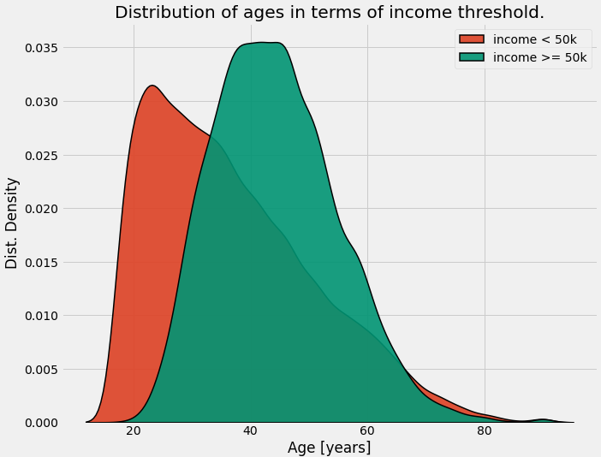
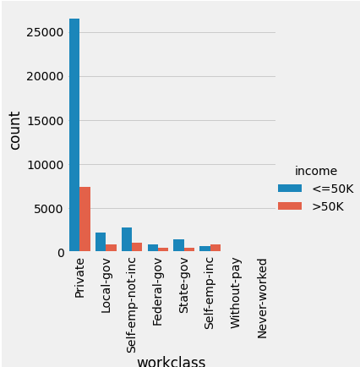
EDA - Age, Working class vs Income
Age vs Income comparison
Income vs education level
Most of the working adults are educated with either high school, college or university degree
Low earning population (<50K) just have HS-grad or some college degree
High earning population (>50K) have bachelor or master degree
Clearly, education levels play important role in adult income prediction

Slide 4
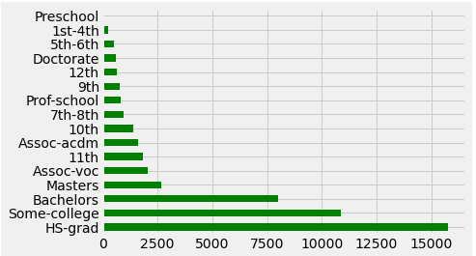
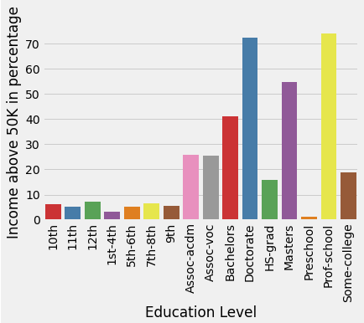
EDA - Education Level vs Income
Education level among adults
Income vs education level
Most of the working adults are educated with either high school, college or university degree
Low earning population (<50K) just have HS-grad or some college degree
High earning population (>50K) have bachelor or master degree
Clearly, education levels play important role in adult income prediction

Slide 5
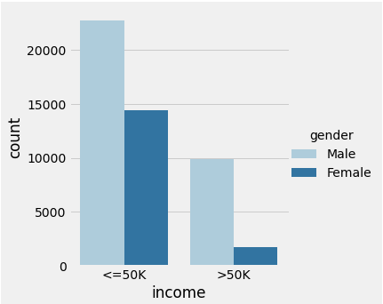
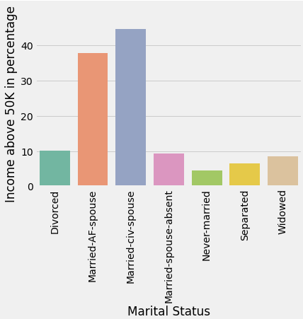
EDA - Gender, marital status vs Income
Income distribution by gender
Income distribution by marital status
Higher number of male population receive far more high salary than female population
In less than $50k income level, never married adults received more salary
But, in above $50k income level, married individuals received more salary

Slide 6
Summary
An individual’s annual income are greatly influenced by several factors
Important features for adult income prediction:
Age
Working class
Educational level
Gender
Marital status
All these variables can have greater impact on an individual’s income status

